Slide 1


Welcome to the Senior
Scholarship Informative

Slide 2
Samantha Adams
Asst. Director of Fund Development
Flagleredfoundation.org
adamss02@flaglerschools.com
(386)437-7526 x1126

Slide 3

flaglerschools.awardspring.com
Use a personal email account when setting up your username and password. Not your Flagler School email account.
The application takes time to complete! Please be sure you do not wait until the night before the deadline to start working on it.
Review available scholarships and requirements.

Slide 4
Letters of Recommendation
Decide who you will ask and make sure you have their email address
Send the request in a timely manner and let the person know what the scholarship deadline is
Ask multiple people
How to Inquire

Slide 5
Reminders
The ‘submit’ button will turn yellow once you have completed everything required
You will need a screenshot of your cumulative GPA
Only one application for multiple scholarships
How to Submit

Slide 6
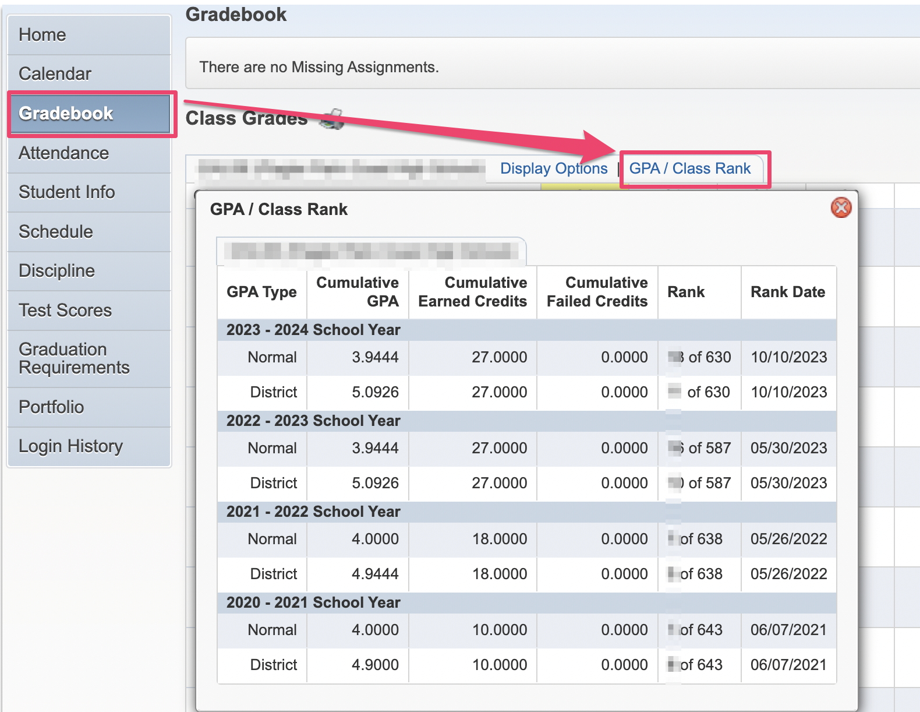
GPA/Rank
How to Submit

Slide 7

Senior Scholarship Program Timeline
November 20, 2023 Online platform opens for students to apply
January 5, 2024 Online platform closes for student applications
January 12, 2024 Organizations start reviewing student applications
April 1, 2024 Invitations for Awards Ceremony distributed to students
May 7, 2024 Scholarship Celebration

Slide 8
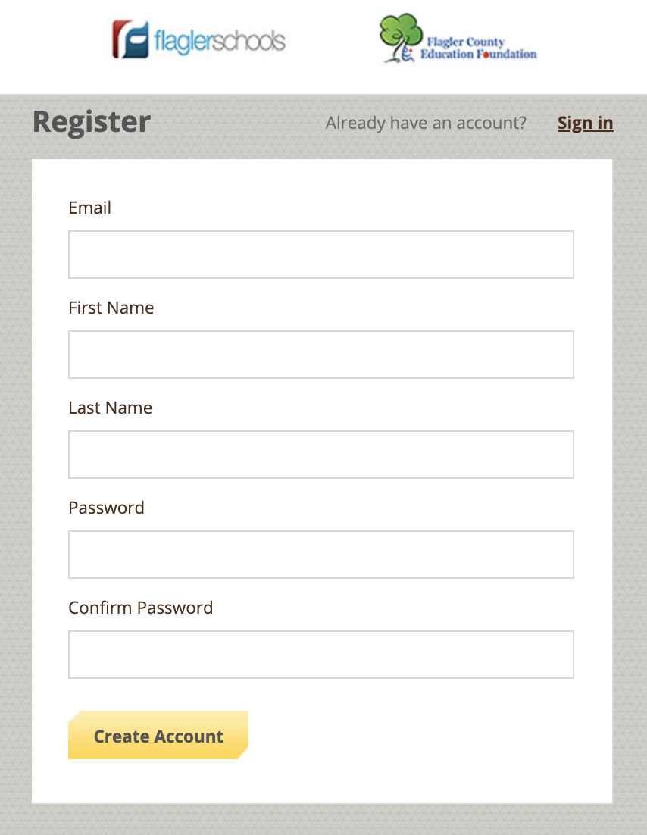
Register at flaglerschools.awardspring.com

Slide 9
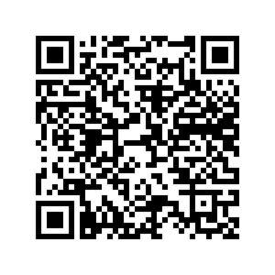
Questions?
Thank you all for coming!

